Slide 1
HNDIT1212: System Analysis and Design
Software Life Cycle Models

Slide 2
SDLC Model
A framework that describes the activities performed at each stage of a software development project.

Slide 3
Various Software Life Cycle Models
Software life cycle models describe various phases of the software cycle and the order in which those phases are executed.
There are tons of models, and many companies adopt their own, but all have very similar patterns. Some of the models as follows.
General Model
Water fall model/ Linear Sequential/ Classic Life Cycle Model
V-Model
Rapid Application Development (RAD) model
Incremental Model
Spiral Model
Proto type model
Fourth Generation (4GT) Techniques

Slide 4
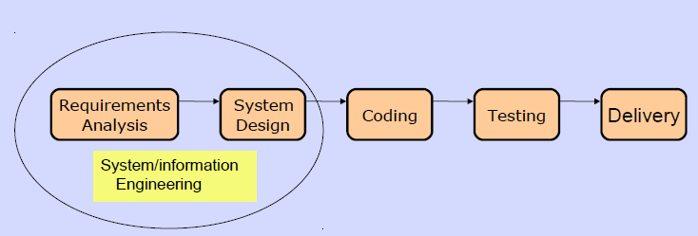
General Life Cycle Model

Slide 5
Linear or Waterfall Cycle
This is the most common and classic of life cycle models, also referred to as a linear sequential life cycle model.
It is very simple to understand and use. In a waterfall model, each phase must be completed in its entirety before the next phase can begin.
At the end of each phase, a review takes place to determine if the project is on the right path and whether or not to continue or discard the project.

Slide 6

Linear or Waterfall Cycle
An approach to system analysis and design
Completes each phase one after another and only once.
Problem Definition
Systems Analysis
Systems Design
Systems Implementation
Systems Testing
Maintenance

Slide 7
Waterfall Strengths
Easy to understand, easy to use
Provides structure to inexperienced staff
Milestones are well understood
Sets requirements stability
Good for management control (plan, staff, track)
Works well when quality is more important than cost or schedule

Slide 8
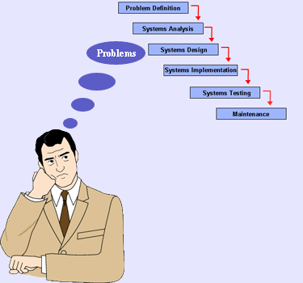
Problems with Waterfall Development Approach

Slide 9
Advantages
Simple and easy to use.
Easy to manage due to the rigidity of the model – each phase has specific
deliverables and a review process.
Phases are processed and completed one at a time.
Works well for smaller projects where requirements are very well understood/stable.
Disadvantages
It’s difficult to respond to changing customer requirements.
Adjusting scope during the life cycle can kill a project
No working software is produced until late during the life cycle.
High amounts of risk and uncertainty.
Poor model for complex and object-oriented projects.
Poor model for long run and ongoing projects.

Slide 10
Modified Waterfall development approach
Problem Definition
Systems Analysis
Systems Design
Systems Implementation
Systems Testing
Maintenance
Notes:
It is iterative process model
One process is wrong again correct to before /other before processes.

Slide 11
Modified Waterfall Development Approach
Uses the same phases as the pure waterfall development approach.
Allow some of the stages to overlap, such as the requirements stage and the design stage.
Overlapping stages make it possible to integrate feedback from the design phase into the requirements.
Progress is more difficult to track.

Slide 12
Incremental/Iterative model
This model does not attempt to start with full specification of requirements. Multiple development cycles take place here, making the life cycle a “multi-waterfall” cycle.
Cycles are divided up into smaller, more easily managed iterations. Each iteration passes through the requirements, design, implementation and testing phases.
A working version of software is produced during the first iteration, so you have working software early on during the software life cycle.
Subsequent iterations build on the initial software produced during the first iteration.

Slide 13
Incremental/Iterative model
Key Points
▪ Development and delivery is broken down into increments
▪ Each increment delivers part of the required functionality
▪ Requirements are prioritized and the highest priority requirements are included in early increments
▪ Once the development of an increment is started, the requirements are frozen
▪ Requirements for later increments can continue to evolve

Slide 14
Iterative development approach
Complete
problem
definition
Iteration # 1
Some
System
Analysis
Some
System
Design
Some
System
Implementation
Iteration # 2
More
System
Analysis
More
System
Design
More
System
Implementation
Iteration # 3
Still more
System
Analysis
Still more
System
Design
Still more
System
Implementation
Repeat until no additional iterations needed

Slide 15
Advantages
▪ System functionality is available earlier and customer does not have to wait as long.
▪ Early increments act as a prototype to help elicit requirements for later increments.
▪ The highest priority functionalities tend to receive more testing.
▪ More flexible – less costly to change scope and requirements.
▪ Easier to test and debug during a smaller iteration.
▪ Easier to manage risk because risky pieces are identified and handled during its iteration.
▪ Each iteration is an easily managed milestone.
Disadvantages
▪ Each phase of an iteration is rigid and do not overlap each other.
▪ Problems may arise pertaining to system architecture because not all requirements are gathered up front for the entire software life cycle.

Slide 16
Prototyping
In this model, a prototype (an early approximation of a final system or product) is built, tested, and then reworked as necessary until an acceptable prototype is finally achieved from which the complete system or product can now be developed.
Prototype paradigm begins with requirements gathering. Developer and customer meet and define the overall objectives for the software, identify whatever requirements are known, and outline areas where further definition is mandatory.

Slide 17
Prototyping…
A quick design occurs which leads to the construction of prototype.
The prototype is evaluated by the customer/user and used to refine the requirements for the software to be developed.
Iteration occurs as the prototype is tuned to satisfy the user requirements, while at the same time enabling developer to better understand what needs to be done.

Slide 18
Prototyping…
It is very difficult for end-users to anticipate how they will use new software systems to support their work. If the system is large and complex, it is probably impossible to make this assessment before the system is built and put into use.
A prototype ( a small version of the system) can be used to clear the vague requirements. A prototype should be evaluated with the user participation.
There are two types of Prototyping techniques
* Throw-away Prototyping
* Evolutionary Prototyping
Notes:
Vague-not clear

Slide 19
Throw-away and Evolutionary Prototyping
Throw-away
prototyping
Executable prototype +
System specification
Outline
Requirements
Evolutionary
prototyping
Delivered system

Slide 20
Throw-away Prototyping
establish outline specification
develop prototype
evaluate prototype
specify system
components
Delivered
software
system
design and implement system
validate system

Slide 21
Throw-away Prototyping
The objective is to understand the system requirements clearly. Starts with poorly understood requirements. Once the requirements are cleared, the system will be developed from the beginning.
This model is suitable if the requirements are vague but stable.

Slide 22
Some problems with Throw-away Prototyping
Important features may have been left out of the prototype to simplify rapid implementation. In fact, it may not be possible to prototype some of the most important parts of the system such as safety-critical functions.
An implementation has no legal standing as a contract between customer and contractor.
Non-functional requirements such as those concerning reliability, robustness and safety cannot be adequately tested in a prototype implementation.

Slide 23
Evolutionary Prototyping
Develop abstract
specification
Build prototype
system
Evaluate prototype
system
NO
YES
System
Adequate?
Deliver
system

Slide 24
Structured Evolutionary Prototyping Strengths
Customers can “see” the system requirements as they are being gathered
Developers learn from customers
A more accurate end product
Unexpected requirements accommodated
Allows for flexible design and development
Interaction with the prototype stimulates awareness of additional needed functionality

Slide 25
Prototyping Weaknesses
Prototyping can lead to false expectations.
Prototyping can lead to poorly designed systems.
Overall maintainability may be overlooked
The customer may want the prototype delivered.
Process may continue forever (scope creep)
Continual change tends to corrupt the structure of the prototype system. Maintenance is therefore likely to be difficult and costly.

Slide 26
The RAD model
Rapid Application Development (RAD) is an incremental software development process model that emphasizes an extremely short development cycle.
If requirements are well understood and project scope is constrained, the RAD process enables a development team to create a ‘fully functional system’ within very short time periods (eg. 60 to 90 days)

Slide 27
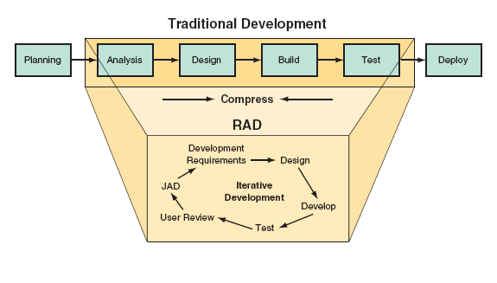

Slide 28
The RAD Model
Team 3
Team 2
Team 1
Business
modeling
Business
modeling
Business
modeling
Data
modeling
Data
modeling
Data
modeling
Process
modeling
Process
modeling
Process
modeling
Application
generation
Application
generation
Application
generation
Testing &
turnover
Testing &
turnover
Testing &
turnover
60 –90 days

Slide 29
Processes in the RAD model
Business modelling - The information flow in a business system considering its functionality.
Data Modelling - The information flow defined as part of the business modelling phase is refined into a set of data objects that are needed to support the business
Process Modelling - The data objects defined in the data modelling phase are transformed to achieve the information flow necessary to implement business functions.
Application generation - RAD assumes the use of 4GL or visual tools to generate the system using reusable components.
Testing and turnover
New components must be tested and all interfaces must be fully exercised
Notes:
Turnover-Pirivatupa

Slide 30
Advantages of RAD
• Can speed up systems development.
• Users thoroughly involved from the start.
• Improves the process of rewriting legacy applications.

Slide 31
Some problems with the RAD model
RAD requires sufficient human resources to create right number of RAD teams
RAD requires developers and customers who are committed to the rapid-fire activities necessary to get a system completed in a much abbreviated time frame.
If a system cannot be properly modularized, building the components necessary for RAD will be problematic.
RAD is not applicable when technical risks are high.

Slide 32
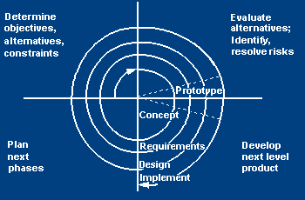
Spiral model
The spiral model (Boehm, 1988) aims at risk reduction by any means in any phase.
quadrant 1
determine objectives of that phase
alternatives and constraints.
quadrant 2
analyzed form the viewpoint of risk
solutions to minimize these risks are investigated, often using prototyping.
quadrant 3
where the traditional waterfall model phases are put into practice.
Quadrant4
the results of the risk-reduction strategies

Slide 33
Spiral model

Slide 34
Spiral Model Strengths
Provides early indication of serious risks, without much cost
Users see the system early because of rapid prototyping tools
Critical high-risk functions are developed first
The design does not have to be perfect
Users can be closely tied to all lifecycle steps
Early and frequent feedback from users

Slide 35
Spiral Model Weaknesses
Time spent for evaluating risks too large for small or low-risk projects
The model is complex
Risk assessment expertise is required
May be hard to define objective, verifiable milestones that indicate readiness to proceed through the next iteration

Slide 36
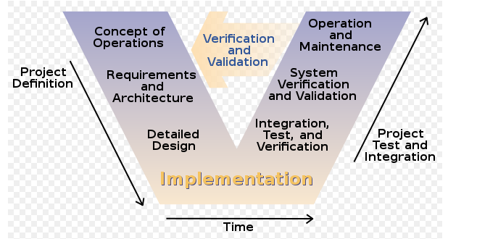
V-Shaped SDLC Model
Testing of the product is planned in parallel with a corresponding phase of development

Slide 37
V-Shaped Strengths
Emphasize planning for verification and validation of the product in early stages of product development
Each deliverable must be testable
Project management can track progress by milestones
Easy to use

Slide 38
V-Shaped Weaknesses
Does not easily handle concurrent events
Does not handle iterations or phases
Does not easily handle dynamic changes in requirements
Does not contain risk analysis activities

Slide 39
Advantages
▪ Simple and easy to use.
▪ Each phase has specific deliverables.
▪ Higher chance of success over the waterfall model due to the development of test
plans early on during the life cycle.
▪ Works well for small projects where requirements are easily understood.
Disadvantages
▪ Very rigid, like the waterfall model.
▪ Little flexibility and adjusting scope is difficult and expensive.
▪ Software is developed during the implementation phase, so no early prototypes of the
software are produced.
▪ Model doesn’t provide a clear path for problems found during testing phases.

Slide 40
Agile Development
Agile development is a software development methodology that delivers functionality in rapid iterations—measured in weeks—requiring frequent communication, development, testing, and delivery.
Agile development focuses on rapid development and frequent user contact to create software that is highly relevant to business users.
This software does not have to include every possible feature the user will require. Rather, it must meet only the basic requirements.

Slide 41
Fourth Generation (4GT) Techniques
Software tool is used to generate the source code automatically for a software
system from a high level specification representation. This is latest technique.

